Slide 1
Android Activities and Fragments
CS 240 – Advanced Programming Concepts

Slide 2
Activities Overview
Represent the screens in your Android application
Divided into two pieces:
The UI layout (normally defined in an xml file with a combination of regular views (widgets) and layouts (containers for other views)
The XxxActivity.java file is where you select and inflate the view for the activity and put your event handling code for the activity and it’s view objects.
Layouts are reusable

Slide 3
Qualified Layouts
Can have separate layouts for different orientations (portrait vs landscape) different screen heights and widths, etc.
Example:
GeoQuiz/QuizActivity

Slide 4
BLANK SLIDE

Slide 5
The Activity Lifecycle

Slide 6
The Activity Lifecycle
Activities have a lifecycle, controlled by the Android system
Things that cause lifecycle/activity state changes:
Creation of a new activity
Activation (manually or programmatically) of an activity that wasn’t active before
Rotation of the device
Interruptions from other apps (i.e. phone calls)
Low memory
Other

Slide 7
The Six Main Activity Callbacks
protected void onCreate(Bundle savedInstanceState)
When the system first creates the activity (set the UI/content view here)
protected void onStart()
The activity is visible to the user (usually no need to implement)
protected void onResume()
Activity is in the foreground and ready for the user to interact with it
protected void onPause()
First indication that the user is leaving the activity. It is no longer in the foreground.
protected void onStop()
Activity is no longer visible to the user
protected void onDestroy()
Activity is about to be destroyed (either because it is finished or there was a configuration change—most commonly a rotation of the device)

Slide 8
Additional Callbacks
protected void onRestart()
Called if the activity was stopped but not destroyed, and is now being restarted
The activity was not active but is about to become active
onStart() will be called next
protected void onSaveInstanceState(Bundle savedInstanceState)
Called between onPause() and onStop()
Provides an opportunity to save state so it can be restored after a configuration change (i.e. rotation)

Slide 9
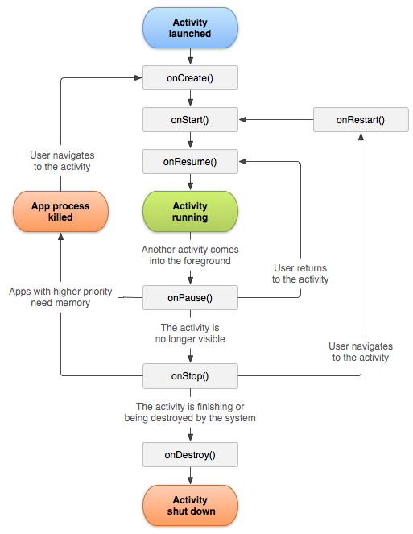
Activity Launched Diagram
onSaveInstanceState(Bundle)
Additional Info:
Understanding the Activity Lifecycle

Slide 10
Activity Lifecycle Demo (ActivityLifecycleExample)
Set logcat to “Debug” and filter on “MainActivity”
Observe the output for the following changes
Initial creation
Rotation
Use of ”recents” button to make another app active
Use of “home” button
Use of “back” button

Slide 11
Citations
1. Simplified Illustration of the activity lifecycle. Developer.android.com. (Apache 2.0 License)

Slide 12
Saving Instance State

Slide 13
Prevent State Loss
Simple changes, like a screen rotation will cause the loss of all instance variable values (because the activity instance is destroyed and recreated)
Example: StateLossExample
3 Solutions
Use onSaveInstanceState(Bundle) callback: SaveInstanceStateExample
Use a ViewModel: ViewModelExample
Use SharedPreferences: SharedPreferencesExample

Slide 14
Use onSaveInstanceState(...) Callback
Use the onSaveInstanceState(Bundle) callback to save state in an activity record before it is lost due to a configuration or other short-term change
Default (inherited) implementation saves state for all UI components. Doesn’t save state for instance variables.
Use the Bundle passed to onCreate(Bundle) to restore state
Be sure to check for a null bundle. If it’s null, there’s no saved state to restore.
Pros:
Will save state across a configuration change or a process death scenario (where the OS kills the activity to preserve memory)
Cons:
State must be serializable
Writes to disk (slow)
Doesn’t save across an application restart

Slide 15
Use a ViewModel
Create a ViewModel class to hold all instance variables for an activity
Pros:
Will save state across a configuration change
State doesn’t need to be serializable
Doesn’t write to disk (fast)
Cons:
Doesn’t save across a process death scenario or application restart

Slide 16
Use SharedPreferences
Write instance variables to SharedPreferences in onStop() callback
Read instance variables from SharedPreferences in onCreate(...) callback
Pros:
Will save state across a configuration change, a process death scenario, or an application restart
Cons:
State must be serializable
Writes to disk (slow)
Not suitable for large amounts of data (use a local or remote database for that)

Slide 17
BLANK SLIDE

Slide 18
Starting an Activity (from another activity)

Slide 19
Starting An Activity
Start an activity (from another activity) by creating an instance of the Intent class and passing it to the startActivity(Intent) method
startActivity(Intent) is defined in the Activity class
Example:
Intent intent = new Intent(MainActivity.this, ReceivingActivity.class);
startActivity(intent);
We usually create intents from an inner class event handler, so this is a reference to the containing activity.
The activity we want to start.

Slide 20
Starting an Activity and Passing Data
(DataPassingExample)
Intent intent = new Intent(MainActivity.this, ReceivingActivity.class);
intent.putExtra(ReceivingActivity.TEXT_KEY, editText.getText().toString());
startActivity(intent);

Slide 21
Retrieving Passed Data in the Started Activity
(DataPassingExample)
public static final String TEXT_KEY = "ReceivedTextKey";
...
Intent intent = getIntent();
String receivedText = intent.getStringExtra(TEXT_KEY);
This intent is available to the activity that was called

Slide 22
Returning Results from an Activity
(DataPassingExample2)
Calling activity creates an ActivityResultLauncher with a callback method for the result
See DataPassingExample2/MainActivity
Calling activity creates an Intent and uses it to launch an activity with the ActivityResultLauncher
See DataPassingExample2/MainActivity
Launched activity creates an Intent, puts result data in the intent as intent extras (if needed), and calls setResult
setResult(int resultCode)
setResult(int resultCode, Intent data)
See DataPassingExample2/ReceivingActivity.setResult(…)

Slide 23
BLANK SLIDE

Slide 24
Applications to Family Map Client

Slide 25
Settings Activity Diagram
Settings Activity
(void) -> boolean
(did settings change?)
Settings menu
Logout
(input) -> output
Main Activity
(void) -> void
embeds
calls
NOTE: The Back button can always be
used to return to the previous activity
Search menu
Login Fragment
(void) -> void
Map Fragment
(event id?) -> void
NOTE: The Up button can always be used
to return all the way back to Main Activity
Click on event details
underneath map
Click on life event
Person Activity
(person id) -> void
Event Activity
(event id) -> void
Click on family member
Click on person search result
Click on event search result
Search Activity
(void) -> void
Diagram by Ken Rodham

Slide 26
Applications to Family Map Client
MainActivity (MapFragment)
PersonActivity is started when event info is clicked (person or personId is passed as intent extra)
Search and Settings activities are started when the menu items are clicked
Depending on how you implement it, Settings activity may return results indicating any changes made by the user
PersonActivity
Clicking a person starts another PersonActivity with the Person or personId passed as an intent extra
Clicking an event starts an EventActivity with the Event or eventId passed as an intent extra

Slide 27
Applications to Family Map Client (cont.)
EventActivity (MapFragment)
PersonActivity is started when event info is clicked (person or personId is passed as intent extra)
SearchActivity
Clicking a person starts a PersonActivity with the Person or personId passed as an intent extra
Clicking an event starts an EventActivity with the Event or eventId passed as an intent extra
SettingsActivity
Logout goes back to MainActivity

Slide 28
BLANK SLIDE

